Slide 1
SCIENTIFIC COMPUTING Algorithms and computational complexity
SEBASTIÁN ROLDÁN VASCO, MSc., PhD.
sebastianroldan@itm.edu.co

Slide 2
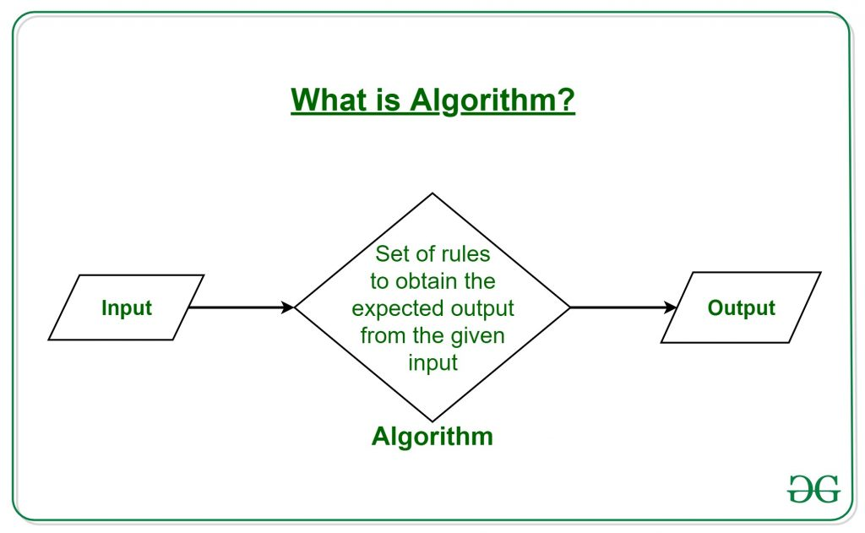
Algorithms
An algorithm is a well-defined computational procedure that takes some value, or set of values, as input and produces some value, or set of values, as output.
https://www.geeksforgeeks.org/introduction-to-algorithms/

Slide 3
Problems solved by algorithms
Some – and extremely limited – examples of problems addressed by algorithms:
Human Genome Project:
100k genes in human DNA
3 billion chemical base pairs
Handling information on Internet
Electronic commerce (personal information, credit cards numbers, passwords, bank statements)
Route planning by Waze
Logistics

Slide 4
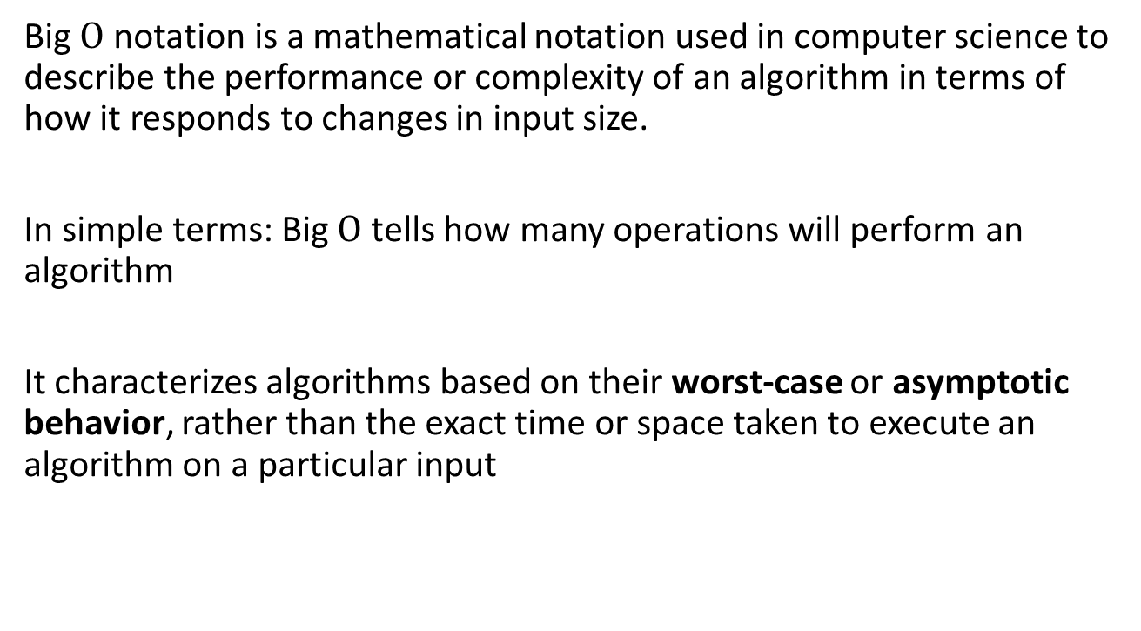

Big Omicron ($Ο$) notation
Big $Ο$ notation is a mathematical notation used in computer science to describe the performance or complexity of an algorithm in terms of how it responds to changes in input size.
In simple terms: Big $Ο$ tells how many operations will perform an algorithm
It characterizes algorithms based on their worst-case or asymptotic behavior, rather than the exact time or space taken to execute an algorithm on a particular input

Slide 5
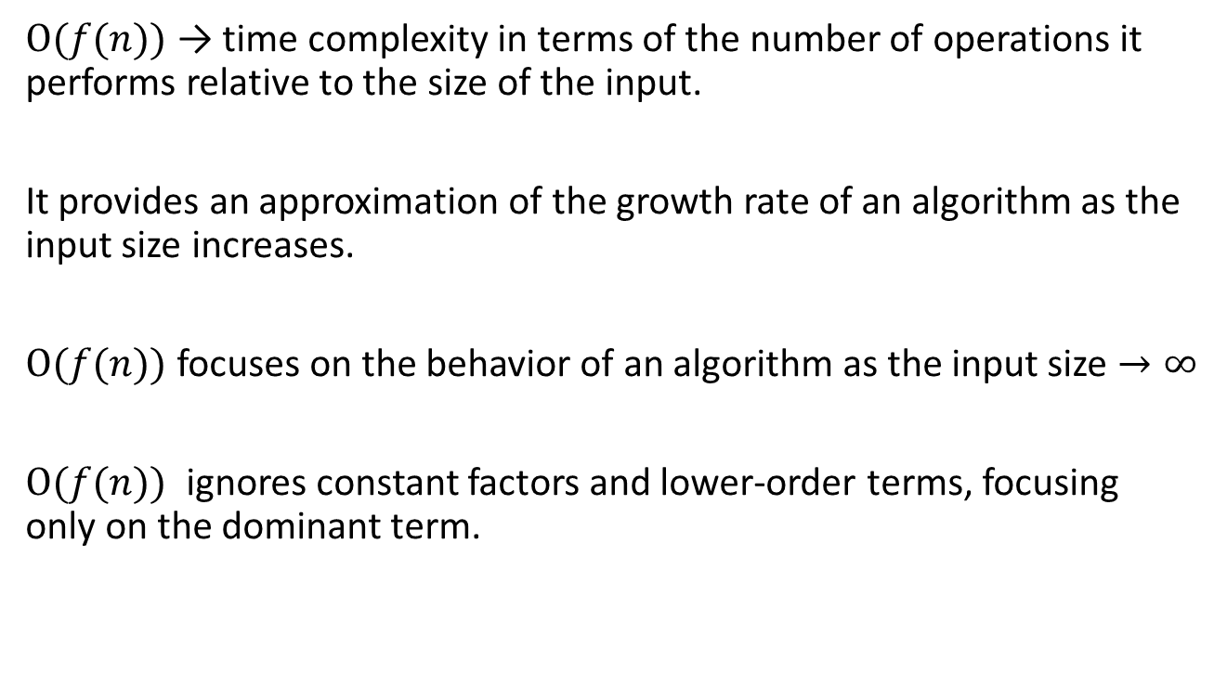

Big $Ο$ notation
$Ο(f(n))$ → time complexity in terms of the number of operations it performs relative to the size of the input.
It provides an approximation of the growth rate of an algorithm as the input size increases.
$Ο(f(n))$ focuses on the behavior of an algorithm as the input size $→∞$
$Ο(f(n))$ ignores constant factors and lower-order terms, focusing only on the dominant term.

Slide 6
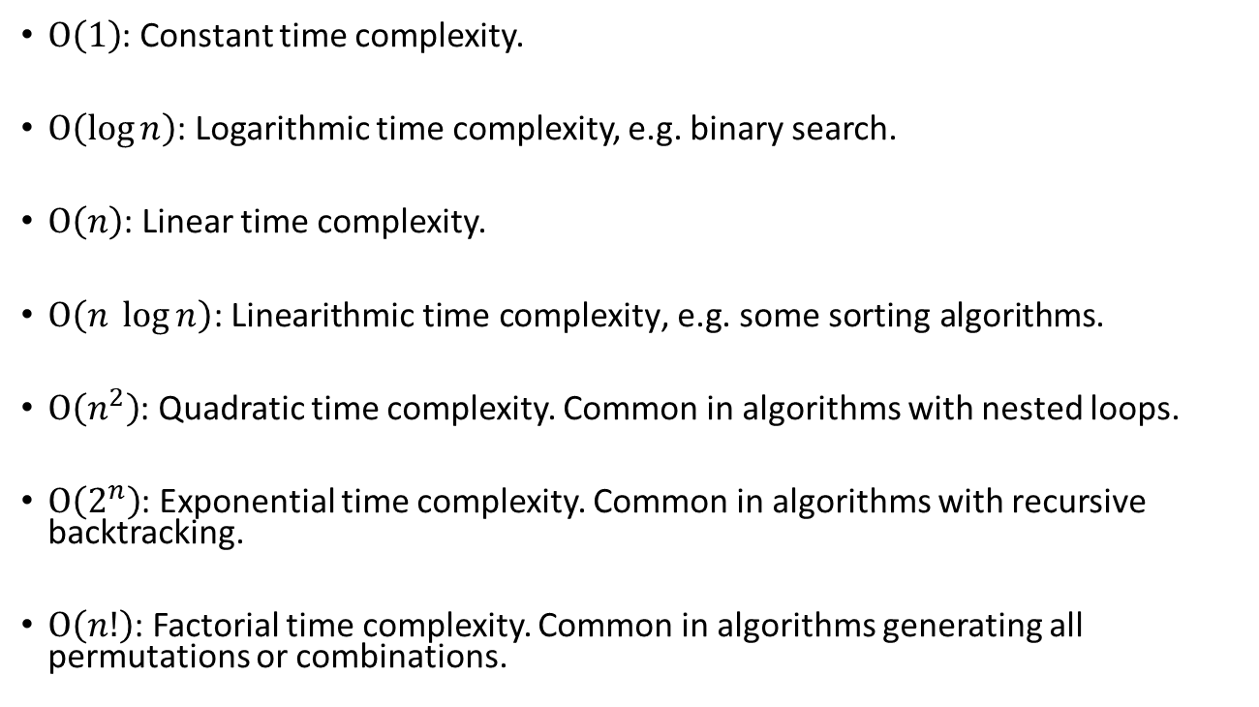

Common big $Ο$notations
$Ο\left(1\right)$: Constant time complexity.
$Ο\left(\log{n}\right)$: Logarithmic time complexity, e.g. binary search.
$Ο\left(n\right)$: Linear time complexity.
$Ο\left(n \log{n}\right)\text{: }\text{L}\text{inear}\text{ithmic} \text{time} \text{complexity}\text{, }\text{e}\text{.}\text{g}\text{. }\text{some} \text{sorting} \text{algorithms}$.
$Ο\left(n^{2}\right)$: Quadratic time complexity. Common in algorithms with nested loops.
$Ο\left(2^{n}\right)$: Exponential time complexity. Common in algorithms with recursive backtracking.
$Ο\left(n!\right)$: Factorial time complexity. Common in algorithms generating all permutations or combinations.

Slide 7
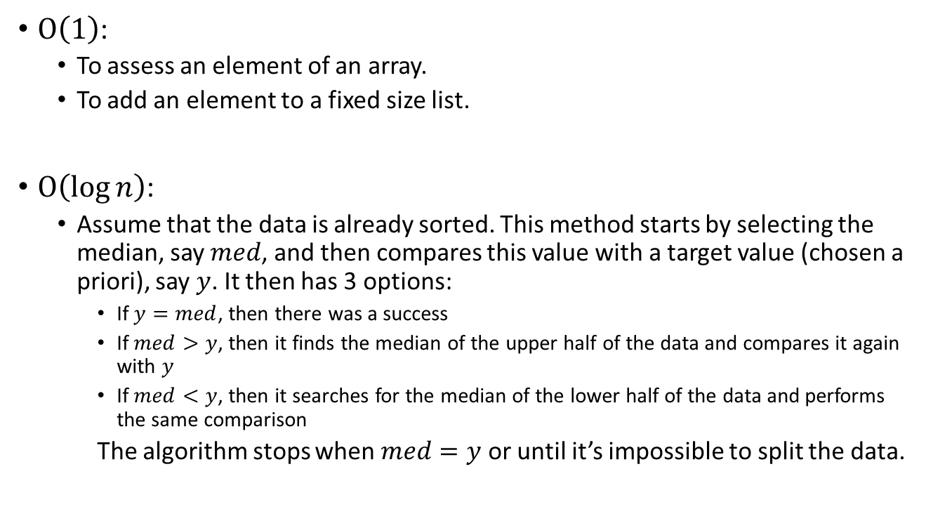
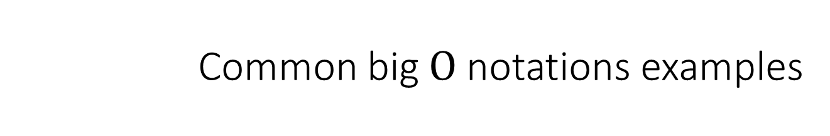
Common big $Ο$notations examples
$Ο\left(1\right)$:
To assess an element of an array.
To add an element to a fixed size list.
$Ο\left(\log{n}\right)$:
Assume that the data is already sorted. This method starts by selecting the median, say $med$, and then compares this value with a target value (chosen a priori), say $y$. It then has 3 options:
If $y=med$, then there was a success
If $med>y$, then it finds the median of the upper half of the data and compares it again with $y$
If $med<y$, then it searches for the median of the lower half of the data and performs the same comparison
The algorithm stops when $med=y$ or until it’s impossible to split the data.
https://www.lancaster.ac.uk/stor-i-student-sites/lidia-andre/2021/04/27/time-complexity-whats-that/

Slide 8
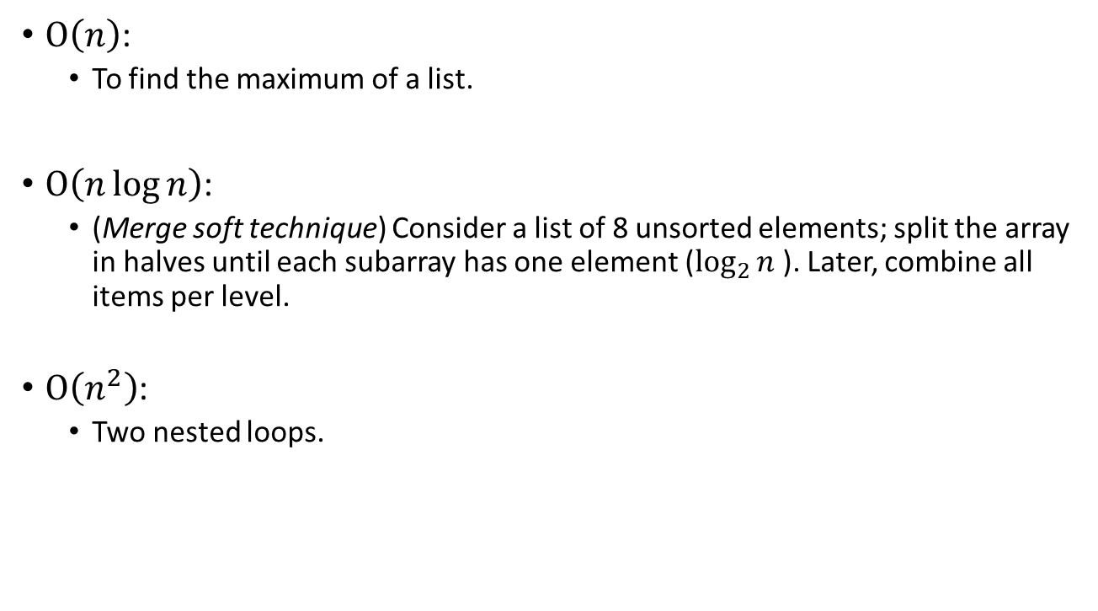
Common big $Ο$notations examples
$Ο\left(n\right)$:
To find the maximum of a list.
$Ο\left(n\log{n}\right)$:
(Merge soft technique) Consider a list of 8 unsorted elements; split the array in halves until each subarray has one element ($\log_{2}{n}$). Later, combine all items per level.
$Ο\left(n^{2}\right)$:
Two nested loops.
https://www.lancaster.ac.uk/stor-i-student-sites/lidia-andre/2021/04/27/time-complexity-whats-that/

Slide 9
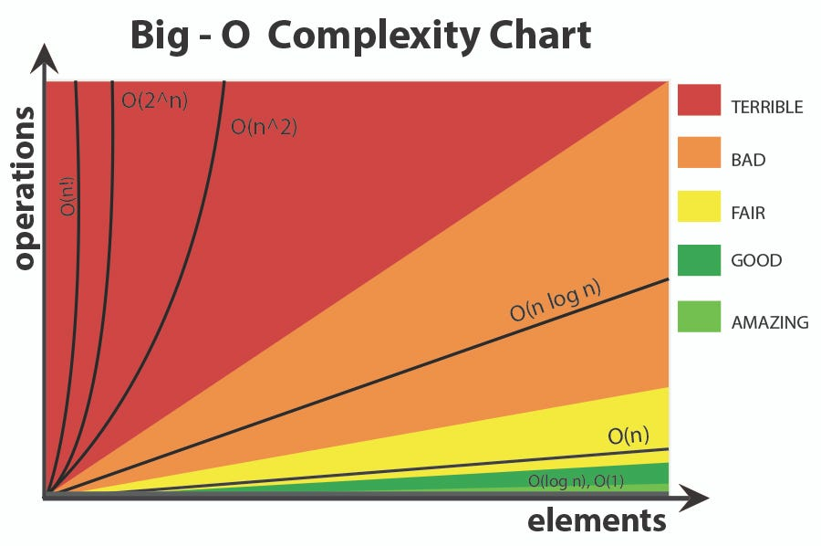

Common big $Ο$ notations
https://medium.com/@deadcookies/a-story-of-big-o-453471a35e62

Slide 10
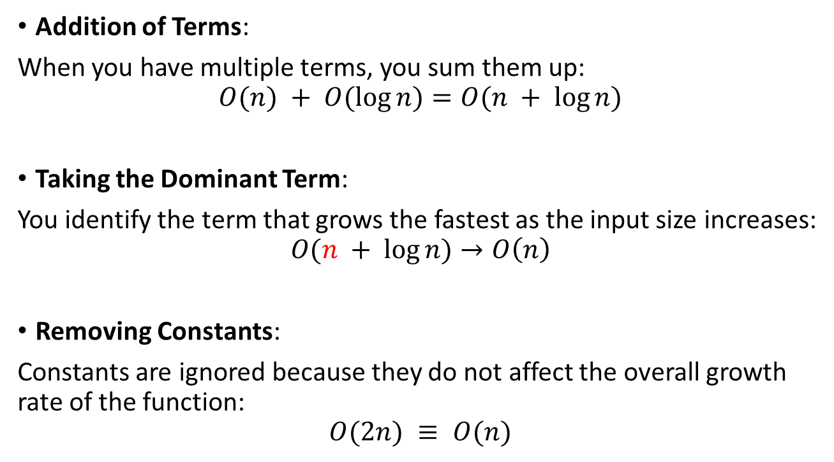
Summing complexities
Addition of Terms:
When you have multiple terms, you sum them up:
$$O(n) + O(log⁡n)=O(n + log⁡n)$$
Taking the Dominant Term:
You identify the term that grows the fastest as the input size increases:
$$O(n + log⁡n)→O\left(n\right)$$
Removing Constants:
Constants are ignored because they do not affect the overall growth rate of the function:
$$O(2n) ≡ O(n)$$

Slide 11
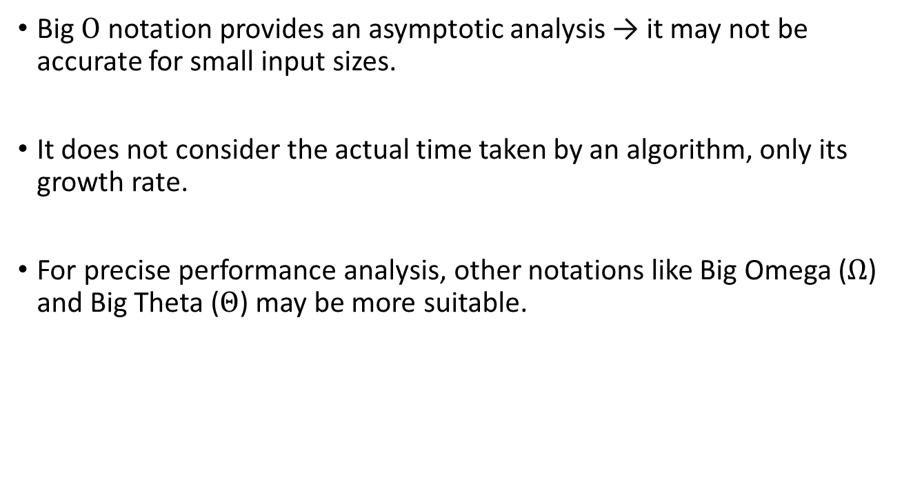

Limitations of the big $Ο$ notation
Big $Ο$ notation provides an asymptotic analysis → it may not be accurate for small input sizes.
It does not consider the actual time taken by an algorithm, only its growth rate.
For precise performance analysis, other notations like Big Omega ($Ω$) and Big Theta ($Θ$) may be more suitable.

Slide 12
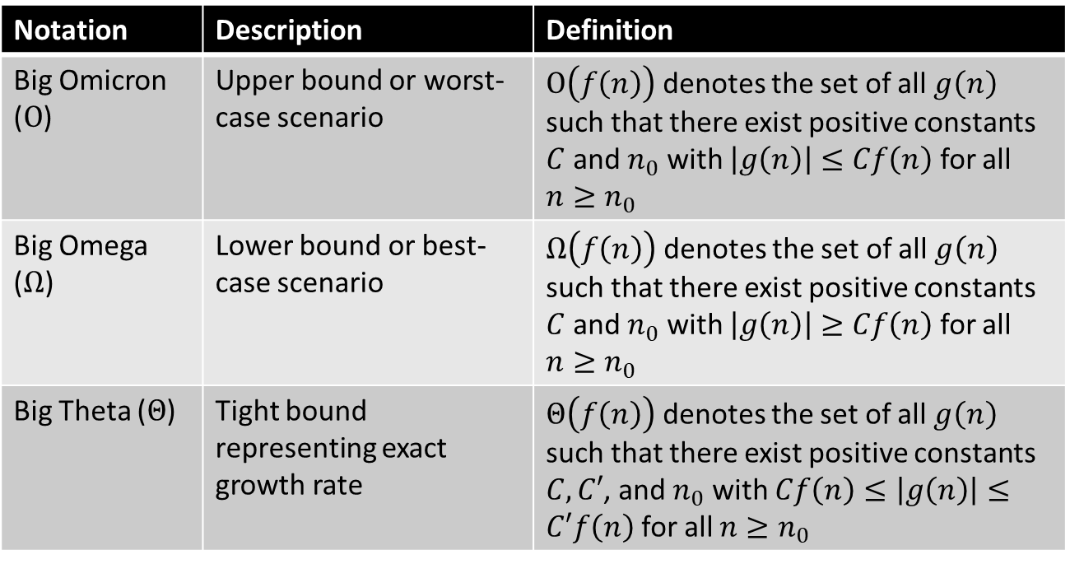
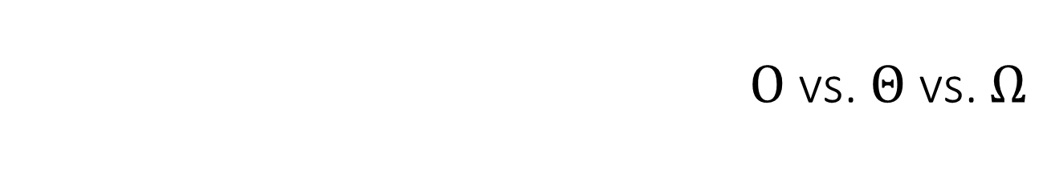
$Ο$ vs. $Θ$ vs. $Ω$
Notation | Description | Definition
Big Omicron ($Ο$) | Upper bound or worst-case scenario | $Ο\left(f\left(n\right)\right)$ denotes the set of all$g\left(n\right)$ such that there exist positive constants $C$ and $n_{0}$ with $\left|g\left(n\right)\right|≤Cf\left(n\right)$ for all $n≥n_{0}$
Big Omega ($Ω$) | Lower bound or best-case scenario | $Ω\left(f\left(n\right)\right)$ denotes the set of all$g\left(n\right)$ such that there exist positive constants $C$ and $n_{0}$ with $\left|g\left(n\right)\right|≥Cf\left(n\right)$ for all $n≥n_{0}$
Big Theta ($Θ$) | Tight bound representing exact growth rate | $Θ\left(f\left(n\right)\right)$ denotes the set of all$g\left(n\right)$ such that there exist positive constants $C, C′$, and $n_{0}$ with $Cf\left(n\right)≤\left|g\left(n\right)\right|≤C′f\left(n\right)$ for all $n≥n_{0}$

Slide 13
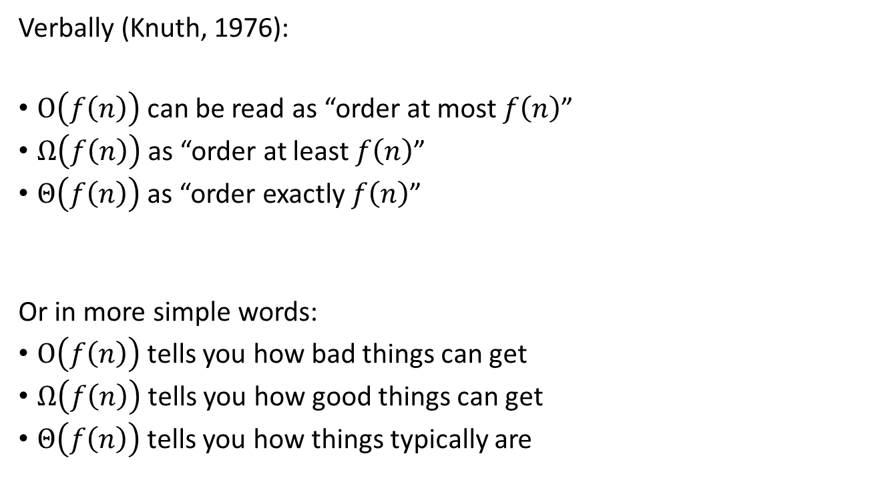
$Ο$ vs. $Θ$ vs. $Ω$
Verbally (Knuth, 1976):
$Ο\left(f\left(n\right)\right)$ can be read as “order at most $f\left(n\right)$”
$Ω\left(f\left(n\right)\right)$ as “order at least $f\left(n\right)$”
$Θ\left(f\left(n\right)\right)$ as “order exactly $f\left(n\right)$”
Or in more simple words:
$Ο\left(f\left(n\right)\right)$ tells you how bad things can get
$Ω\left(f\left(n\right)\right)$ tells you how good things can get
$Θ\left(f\left(n\right)\right)$ tells you how things typically are
Knuth, D. E. (1976). Big omicron and big omega and big theta. ACM Sigact News, 8(2), 18-24.

Slide 14
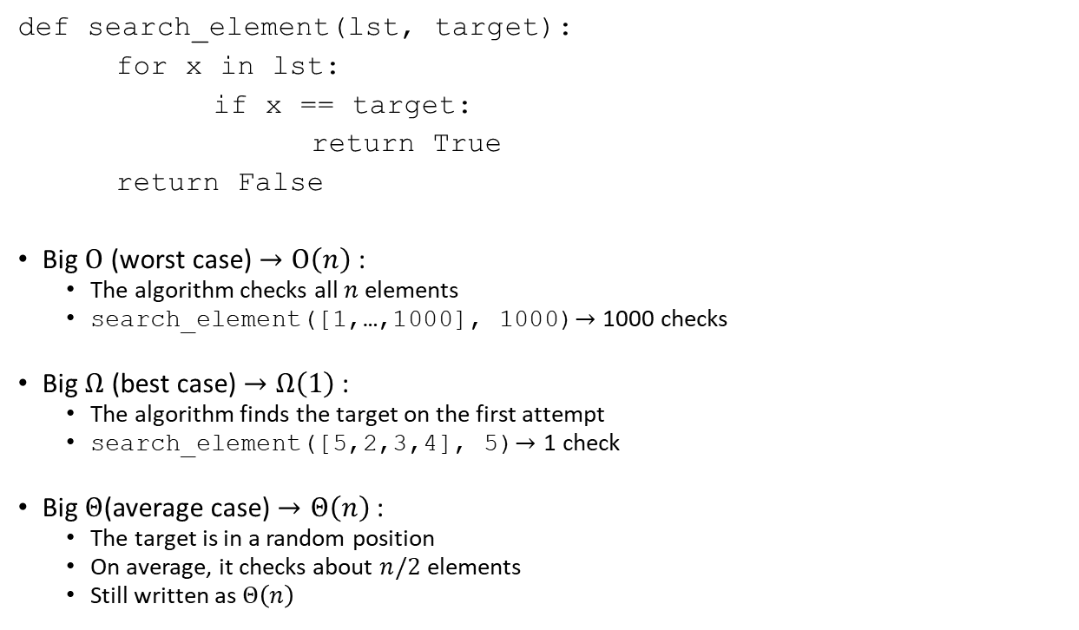
$Ο$ vs. $Θ$ vs. $Ω$
def search_element(lst, target):
for x in lst:
if x == target:
return True
return False
Big $Ο$ (worst case) $→Ο\left(n\right)$:
The algorithm checks all $n$ elements
search_element([1,…,1000], 1000)$→\text{1000} \text{checks}$
Big $Ω$ (best case) $→Ω\left(1\right)$:
The algorithm finds the target on the first attempt
search_element([5,2,3,4], 5)$→\text{1} \text{check}$
Big $Θ$(average case) $→Θ\left(n\right)$:
The target is in a random position
On average, it checks about $n/2$ elements
Still written as $Θ\left(n\right)$

Slide 15
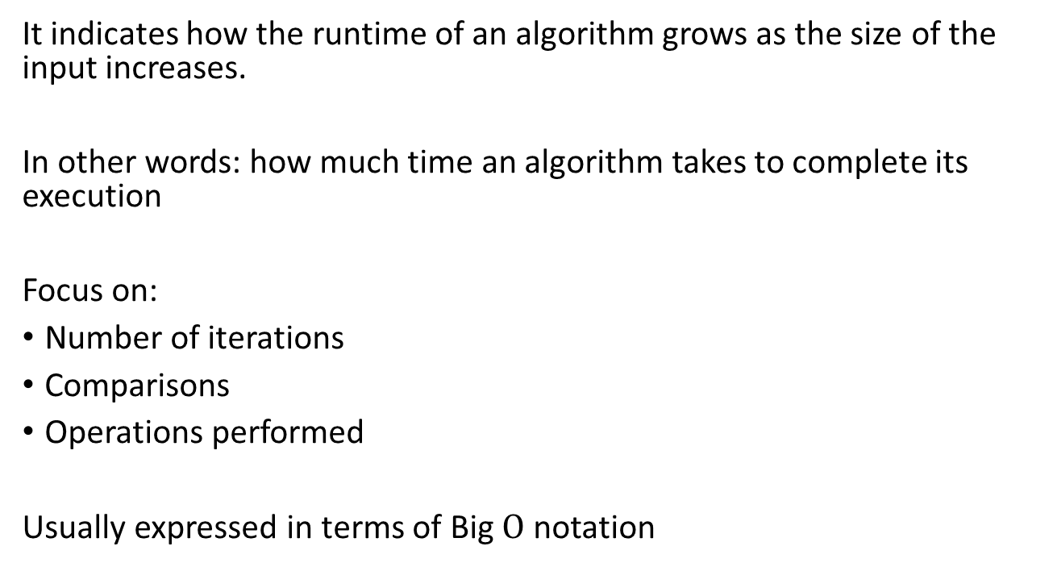
Temporal complexity
It indicates how the runtime of an algorithm grows as the size of the input increases.
In other words: how much time an algorithm takes to complete its execution
Focus on:
Number of iterations
Comparisons
Operations performed
Usually expressed in terms of Big $Ο$ notation

Slide 16
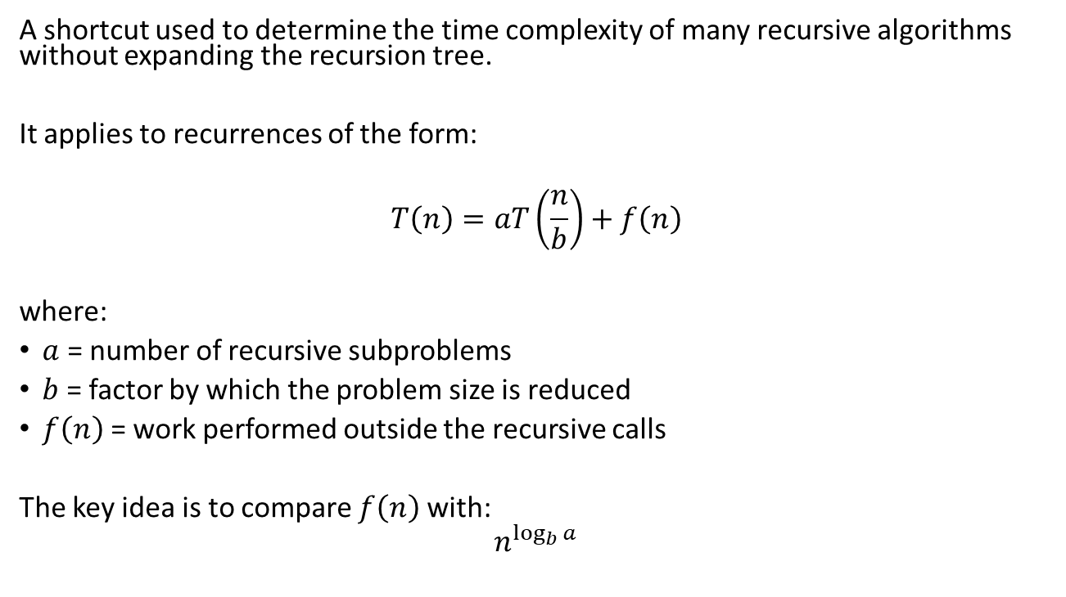
Temporal complexity – Master Theorem
A shortcut used to determine the time complexity of many recursive algorithms without expanding the recursion tree.
It applies to recurrences of the form:
$$T\left(n\right)=aT\left(\frac{n}{b}\right)+f\left(n\right)$$
where:
$a$ = number of recursive subproblems
$b$ = factor by which the problem size is reduced
$f\left(n\right)$ = work performed outside the recursive calls
The key idea is to compare $f\left(n\right)$ with:
$$n^{\log_{b}{a}}$$

Slide 17
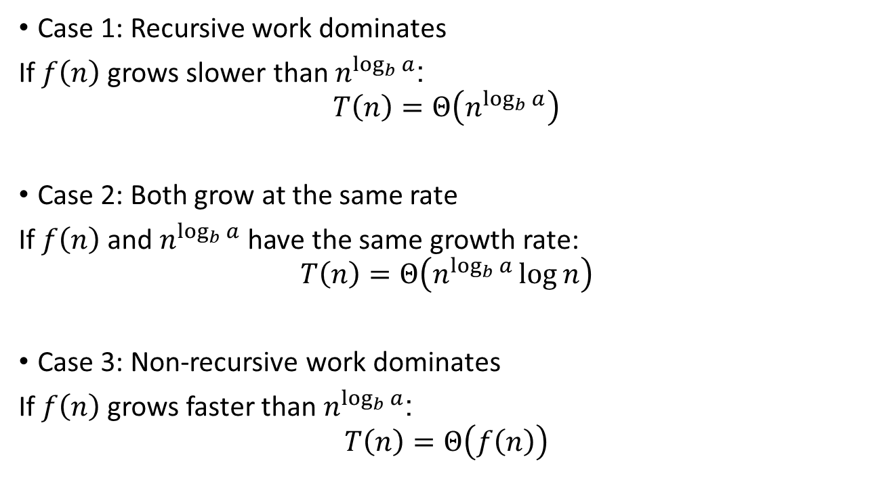
Temporal complexity – Master Theorem
Case 1: Recursive work dominates
If $f\left(n\right)$ grows slower than $n^{\log_{b}{a}}$:
$$T\left(n\right)=Θ\left(n^{\log_{b}{a}}\right)$$
Case 2: Both grow at the same rate
If $f\left(n\right)$ and $n^{\log_{b}{a}}$ have the same growth rate:
$$T\left(n\right)=Θ\left(n^{\log_{b}{a}}\log{n}\right)$$
Case 3: Non-recursive work dominates
If $f\left(n\right)$ grows faster than $n^{\log_{b}{a}}$:
$$T\left(n\right)=Θ\left(f\left(n\right)\right)$$

Slide 18
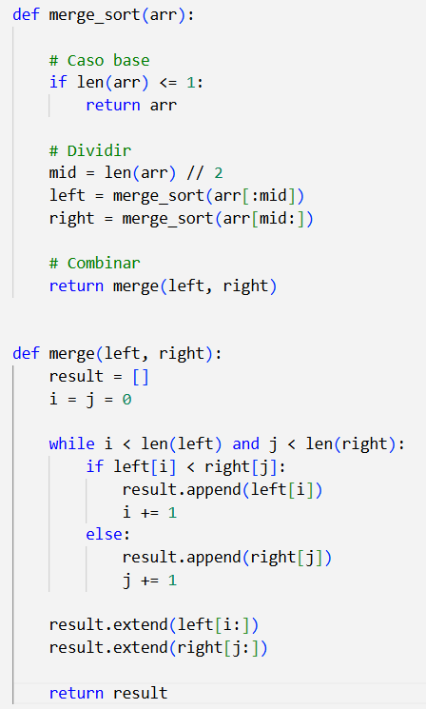
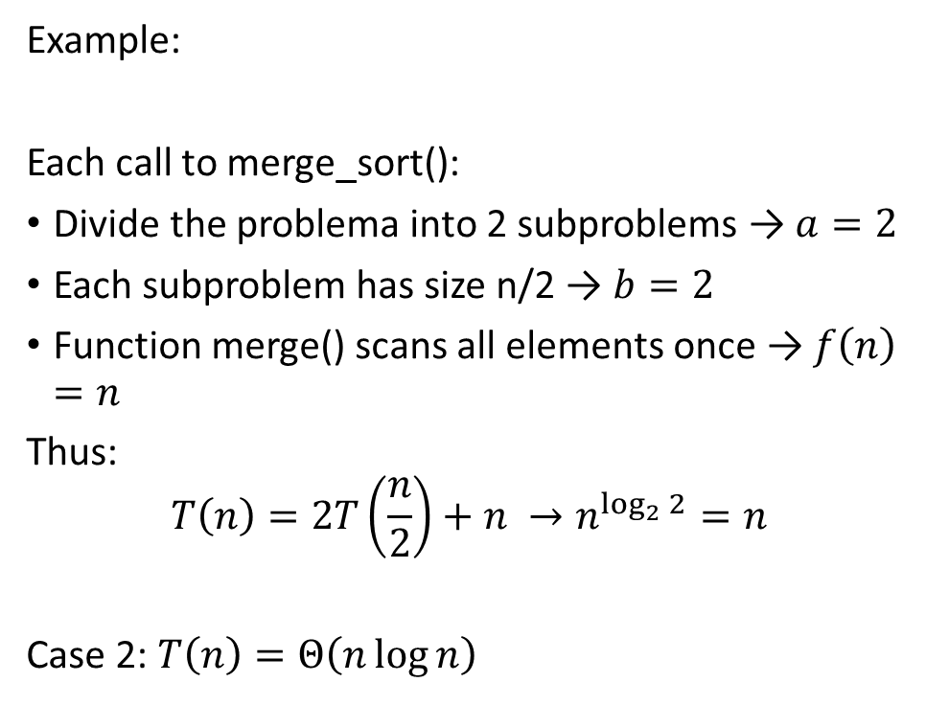
Temporal complexity – Master Theorem
Example:
Each call to merge_sort():
Divide the problema into 2 subproblems → $a=2$
Each subproblem has size n/2 → $b=2$
Function merge() scans all elements once → $f\left(n\right)=n$
Thus:
$$T\left(n\right)=2T\left(\frac{n}{2}\right)+n →n^{\log_{2}{2}}=n$$
Case 2: $T\left(n\right)=Θ\left(n\log{n}\right)$

Slide 19
Spatial complexity
It indicates how much memory an algorithm consumes as the size of the input increases
In other words: how much memory an algorithm uses, often expressed in terms of memory allocation.
Focus on:
Number of variables
Data structures
Auxiliary space required
Essential in memory-constrained environments such as embedded systems or when dealing with large datasets.

Slide 20
How to compute the complexity
Identify the Input Size
The size of an array, the number of elements in a list, the length of a string, etc
Identify Basic Operations
Arithmetic operations, comparisons, and iter (loops)
Analyze Loops
# iter according to the input size, nested loops
Calculate Total Operations
$Σ$ inside loops, $Π$ by # iter
Σ inside loops, Π by # iter
Express Temporal Complexity
Big $Ο$, identify the dominating factor for runtime
Big Ο, identify the dominating factor for runtime

Slide 21
How to compute the complexity
Analyze Memory Usage
Analyze memory requirements according to data structures
Express Spatial Complexity
Big $Ο$, identify the dominating factor
Big Ο, identify the dominating factor
Verify and refine
Test with different input sizes: measure the actual runtime and memory usage
Consider Best, Worst, and Average Cases
Consider them separately

Slide 22
Algorithm optimization
There are several strategies to optimize the algorithms:
Complexity analysis
Use of efficient data structures, e.g. dictionaries vs. Lists for Access
Efficent algorithms
Loops optimization
Avoiding duplicate calculations
Divide-and-conquer (Dynamic programming)
Removing dead code
Optimizing critical operations
Code profiling → use profiling tools to identify parts of the code that consume the most resources

Slide 23
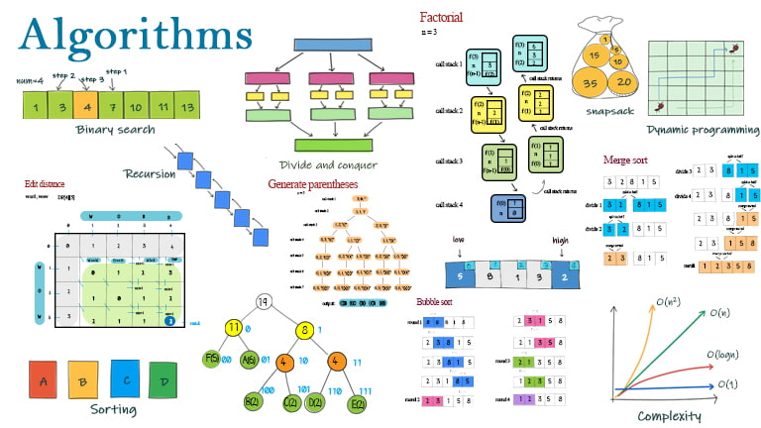
Algorithm types
https://www.lavivienpost.com/algorithms-types-and-algorithm-examples/

Slide 24
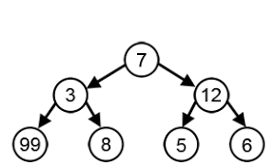
Algorithm types
Greedy algorithm
It makes locally optimal choices at each step with the hope of finding a global optimum.
Pros: Simple, straightforward, efficient (time complexity)
Cons: Optimal solution is not guaranteed (local optima)
“It is essentially a mathematical process that, by deciding which next step will provide the most obvious benefit, hunts for simple solutions (which are easy to implement)” https://www.engati.com/glossary/greedy-algorithm

Slide 25
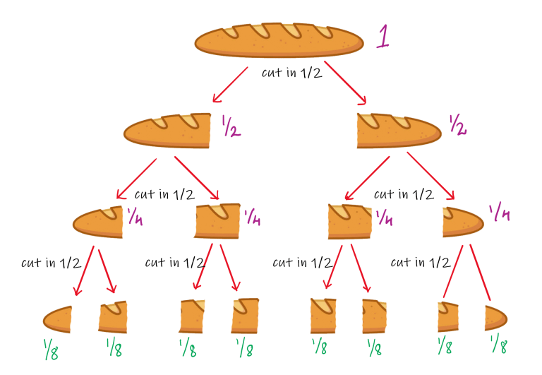
Algorithm types
2. Divide and Conquer Algorithm
It recursively breaks down a problem into smaller subproblems, solve them independently, and then combine their solutions to solve the original problem.
Pros: Efficient for recursive problems, elegant and straightforward solutions
Cons: Can have high spatial complexity, not efficient for all problems
https://studyalgorithms.com/theory/algorithmic-paradigms-divide-and-conquer/

Slide 26

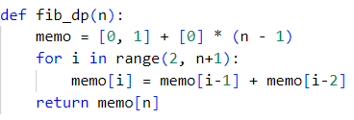


Algorithm types
3. Dynamic programming
It solves complex problems by breaking them into simpler subproblems and storing the solutions to avoid redundant computations.
Pros: Optimal solutions for many problems, avoids redundant computations
Cons: Can have high spatial complexity, not suitable for problems with overlapping subproblems
$$O\left(2^{n}\right)$$
$$O\left(n\right)$$

Slide 27
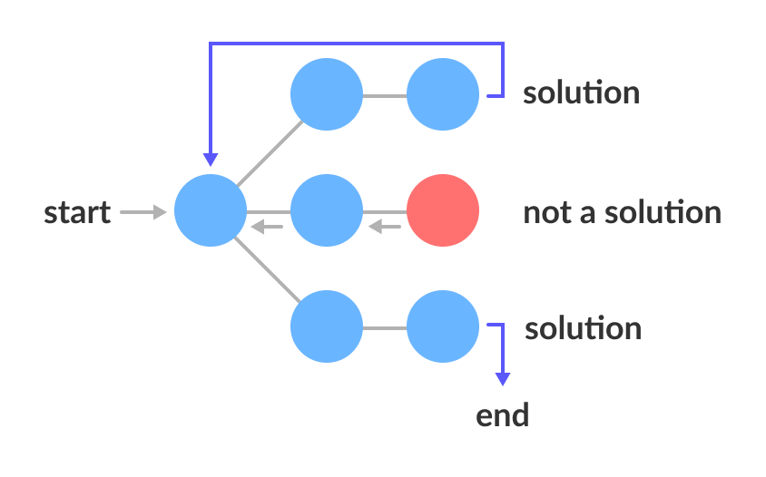
Algorithm types
4. Backtracking algorithm
It systematically explores all possible solutions to a problem by trying each option recursively and backtracking when a solution is found to be invalid.
Pros: Guarantees finding a solution if it exists
Cons: Computationally expensive in problems with large search space, not efficient in problems with redundant paths
https://www.programiz.com/dsa/backtracking-algorithm

Slide 28
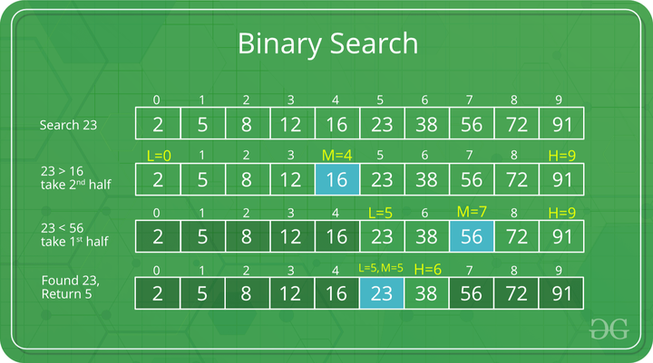
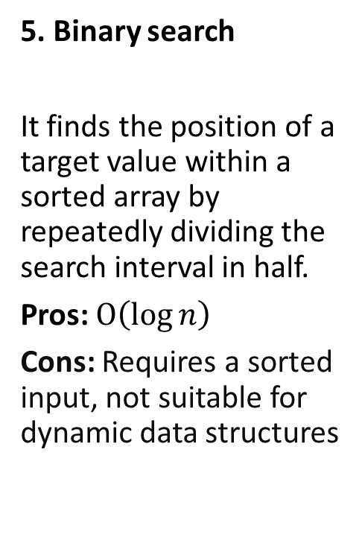
Algorithm types
5. Binary search
It finds the position of a target value within a sorted array by repeatedly dividing the search interval in half.
Pros: $Ο\left(\log{n}\right)$
Cons: Requires a sorted input, not suitable for dynamic data structures
https://www.geeksforgeeks.org/binary-search/

Slide 29
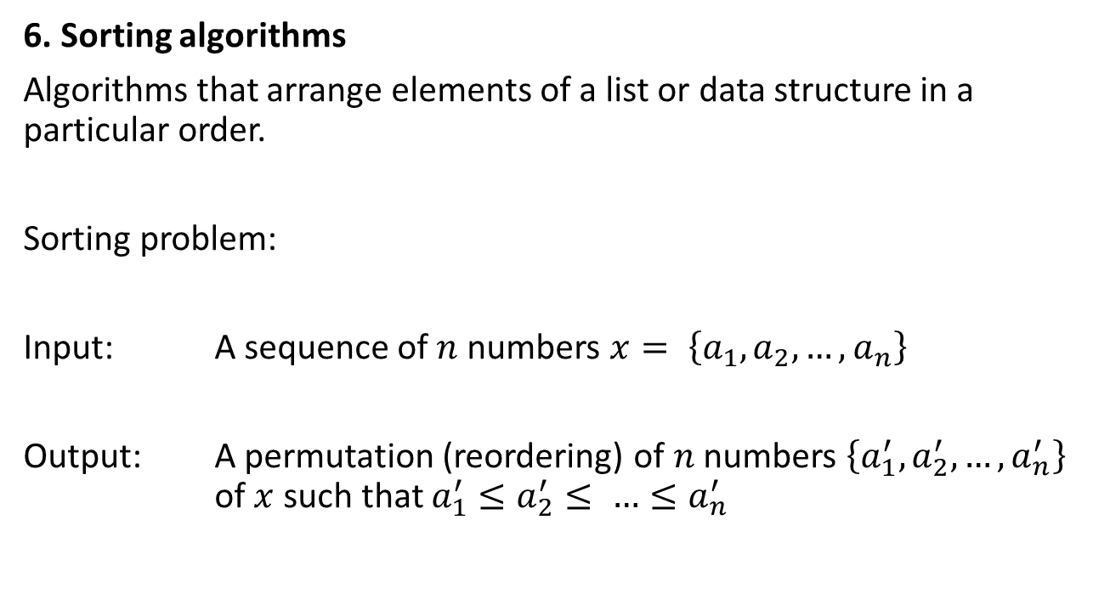
Sorting algorithms
6. Sorting algorithms
Algorithms that arrange elements of a list or data structure in a particular order.
Sorting problem:
Input: A sequence of $n$ numbers $x= \left\{a_{1},a_{2}, …, a_{n}\right\}$
Output: A permutation (reordering) of $n$ numbers $\left\{a_{1}^{′},a_{2}^{′}, …,a_{n}^{′}\right\}$ of $x$ such that $a_{1}^{′}≤a_{2}^{′}≤ …≤a_{n}^{′}$

Slide 30
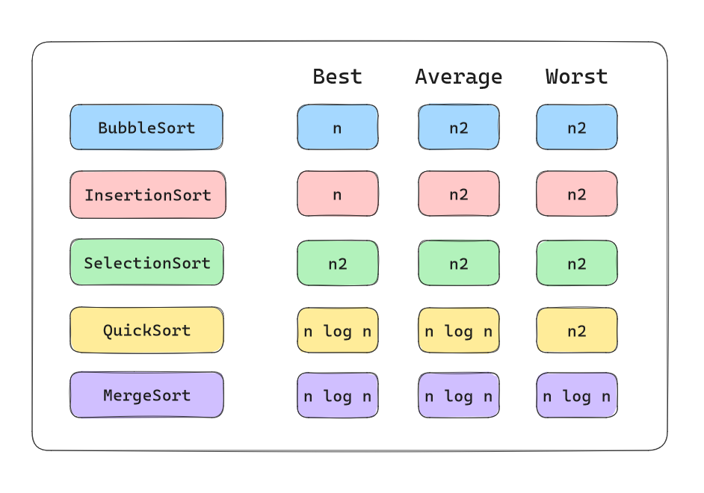
Sorting algorithms
https://medium.com/@kamiviolet/how-to-sort-data-summary-of-5-types-of-sorting-in-programming-part-1-6e81084413f

